Slide 1
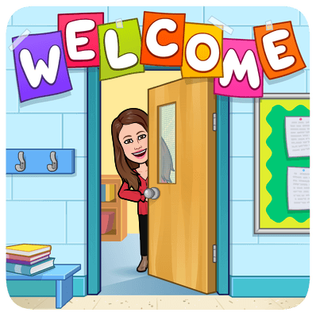

Slide 2
About Ms. Otero
I have been working in public schools for 20 years
This is the start of my 4th year at PAHS
Worked as the Library Club Advisor for three years
I worked at PA Vo-Tech during my first three years of teaching
I am happily married and I have three kids
deniotero@paps.net

Slide 3
About Mrs. Welch
I have been a Perth Amboy district employee for 35 years
I have been a High School English teacher for 12 years
Worked as Sophomore and Junior class advisor
Worked as Key Club Advisor
I LOVE to travel, watch foreign films, attend sporting events, read suspense novels, take nature walks, road trips and to try new foods.
loriwelch@paps.net

Slide 4
About Ms. Landi
I have been an English Teacher for 11 years
This is my 9th year at Perth Amboy High School
Worked as the Sophomore Junior Class of 2021 Advisor
Working on my Masters Degree at Kean University
tinalandi@paps.net

Slide 5
Contact information:
Email:
Deniotero@paps.net
loriwelch@paps.net (Period 3 and 6)
tinalandi@paps.net (Period 9)

Slide 6
Syllabus (Grade 12)
This year we will be covering the following:
Springboard’s Reading Workshop
Springboard’s Writing Workshop
Novel Study: Brave New World
Drama Study: Antigone
College Essay Writing/SAT Boot Camp
Springboard’s reading and writing programs allow the students to have a more focused instruction with practice in various crucial skills.

Slide 7
Syllabus (Grade 10)
This year we will be covering the following:
Springboard’s Reading Workshop
Springboard’s Writing Workshop
Novel Study: The Great Gatsby
Drama Study: Julius Caesar
Springboard’s reading and writing programs allow the students to have a more focused instruction with practice in various crucial skills.

Slide 8
Class rules and expectations
Be on time
Do not exit until they have been told to
Cameras must be on at all times and students must be in full view (participation points are deducted for noncompliance)
Students must be on mute at all times (unless they have a question)
Students should not be on their phones or playing video games
Students must be respectful

Slide 9
Online Materials
A fully charged Chromebook
A notebook and something to write with
Reading materials (when we are using them)

Slide 10
Grading Policy
35 % Classwork
5 % Homework
60 % Tests, Quizzes, Essays
Because we are in remote learning (and computers and the internet are sometimes unreliable), students will always be given an extra day to complete assignments. However, I will not give make-up work or extra credit at the end of the marking period.

